Slide 1
Here is a suggested title for the paragraph: "Artificial Intelligence: A New Horizon"

Slide 2
"What is Artificial Intelligence?
The report provides an accessible, scientifically and technologically accurate portrayal of the current state of AI and its potential.

Slide 3
Transportation
Artificial intelligence (AI) is the simulation of human intelligence processes by computer systems. These processes include learning (the acquisition of information and rules for using the information), reasoning (using the rules to reach approximate or definite conclusions), and selfcorrection.

Slide 4
Healthcare
The report also highlights the potential for AI to improve health outcomes and quality of life for millions of people in the coming years.

Slide 5
AI in the City
The past fifteen years have seen considerable AI advances in education. The use of intelligent tutors and other AI technologies to assist teachers in the classroom and in the home is likely to expand significantly.

Slide 6
"AI and Policing"
The potential impact of artificial intelligence (AI) on the future of policing in a typical North American city is significant. While there are legitimate concerns that AIbased policing may become overbearing or pervasive in some contexts, the opposite is also possible.

Slide 7
"AI and Employment"
The report highlights the impact of digital technologies on employment, and how AI will likely affect the future of work. It notes that AI is likely to replace tasks rather than jobs in the near term, and create new kinds of jobs. However, it also highlights the need for AI innovations to overcome human fears of being marginalized.

Slide 8
Entertainment
The explosive growth of the internet has changed the way people interact and entertain themselves. AI is playing a major role in this transformation.

Slide 9
"AI and the Future of Finance and Economics"
AI has impacted every aspect of our lives. It has the potential to change the way we live, work, and play. It can help us solve problems and make our lives easier.

Slide 10
Video Games
The artificial intelligence (AI) market is growing rapidly, with investment in the sector increasing threefold between 2013 and 2016. AI is being used in a variety of industries, including retail, utilities, and automakers. The technology is also being developed for use in video games.

Slide 11
The title for the paragraph is: "The Future of Artificial Intelligence"
The global artificial intelligence market is expected to grow by 175% from prior levels, reaching a forecast size of $2.4bn. AI can deliver real value to companies willing to use it across operations and within their core functions.

Slide 12
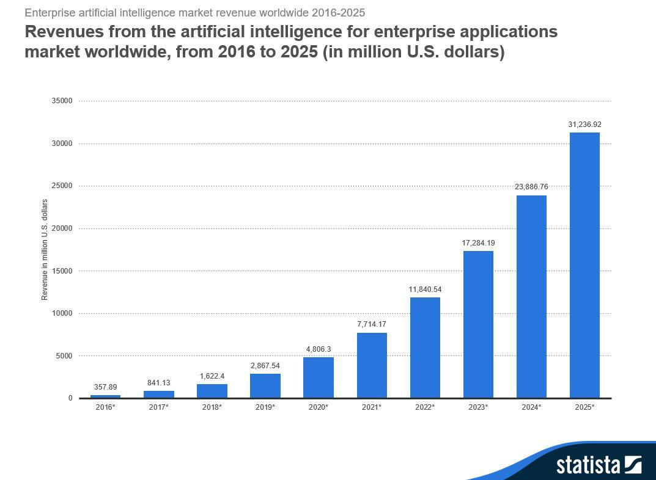

Slide 13
Artificial Intelligence: The Next Great Technological Shift
The development of artificial intelligence (AI) has been a longstanding goal of computer science. AI has the potential to transform society in ways we can't yet imagine.

Slide 14
The key phrase is "AI safety research" which is a field of research that focuses on the safety of AI systems.
The paper discusses the risks associated with artificial intelligence and the need for AI safety research. It also highlights the importance of ensuring that AI systems are able to adapt to new contexts.

